Slide 1

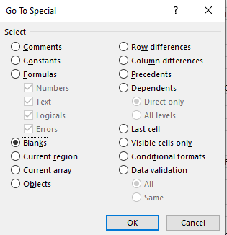


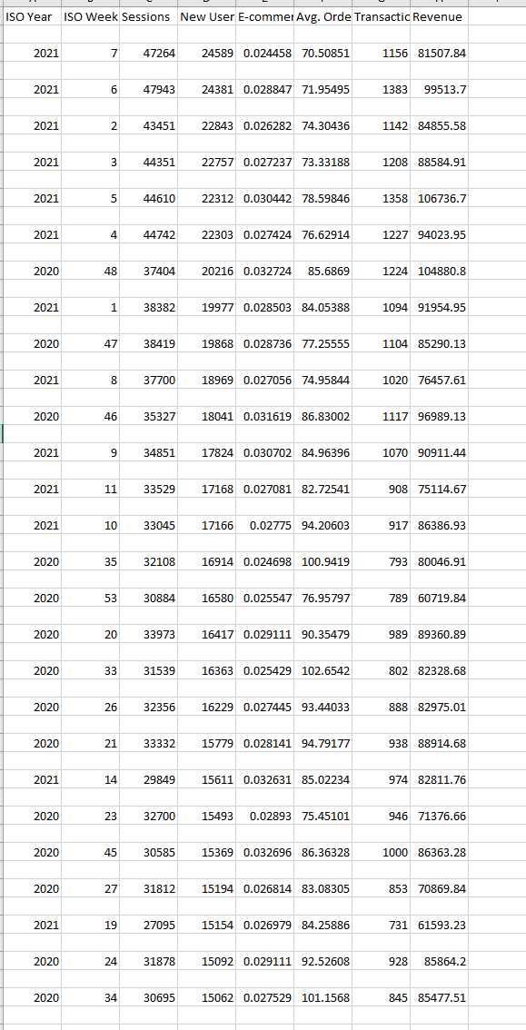
Data Cleaning
The first thing I noticed was the blank cells, these needed to be removed! I used this nifty option in Excel to select all blank cells then proceeded to delete these using the delete cells option under the home ribbon. Next I checked for duplicates using the Excel function. I then formatted the data values to the correct values, changing revenue to currency, E-commerce Conversion rate to a percentage etc.
I also changed the week starting into actual date values using a formula as this can give better visualization of insights when looking for patterns and trends.
Finally I formatted the data into a table allowing the sorting of data by date , smallest to largest. I did so this way to make it easy to add new cells if the need would arise.
ISO Year | ISO Week of the Year | Week Starting | Quarter | Sessions | New Users | E-commerce Conversion Rate | Avg. Order Value | Transactions | Revenue | E-comerce Conversion Rate New Users
2020 | 1 | 01/01/2020 | Q1 | 15509 | 7844 | 2.63% | £97.97 | 408 | £39,970.46 | 5.20%
2020 | 2 | 06/01/2020 | Q1 | 23224 | 10918 | 3.11% | £117.82 | 723 | £85,184.07 | 6.62%
2020 | 3 | 13/01/2020 | Q1 | 24996 | 12727 | 2.66% | £97.15 | 665 | £64,603.61 | 5.23%
2020 | 4 | 20/01/2020 | Q1 | 25987 | 13249 | 2.61% | £105.79 | 677 | £71,617.34 | 5.11%
2020 | 5 | 27/01/2020 | Q1 | 21188 | 9628 | 3.36% | £112.51 | 712 | £80,104.10 | 7.40%
2020 | 6 | 03/02/2020 | Q1 | 19553 | 9308 | 3.08% | £96.83 | 603 | £58,386.13 | 6.48%
2020 | 7 | 10/02/2020 | Q1 | 18295 | 7935 | 3.26% | £121.74 | 597 | £72,676.08 | 7.52%
2020 | 8 | 17/02/2020 | Q1 | 18577 | 8178 | 3.08% | £100.41 | 572 | £57,435.45 | 6.99%
2020 | 9 | 24/02/2020 | Q1 | 19099 | 8915 | 3.38% | £99.63 | 646 | £64,363.67 | 7.25%
2020 | 10 | 02/03/2020 | Q1 | 21325 | 10134 | 3.33% | £109.07 | 710 | £77,438.45 | 7.01%
2020 | 11 | 09/03/2020 | Q1 | 22689 | 10866 | 3.72% | £128.34 | 844 | £108,319.34 | 7.77%
2020 | 12 | 16/03/2020 | Q1 | 23363 | 11574 | 4.20% | £115.74 | 981 | £113,543.85 | 8.48%
2020 | 13 | 23/03/2020 | Q1 | 22011 | 10910 | 3.21% | £82.78 | 706 | £58,445.53 | 6.47%
2020 | 14 | 30/03/2020 | Q1 | 23115 | 10852 | 3.27% | £72.01 | 756 | £54,440.95 | 6.97%
2020 | 15 | 06/04/2020 | Q2 | 21173 | 10187 | 2.35% | £81.96 | 498 | £40,816.64 | 4.89%
2020 | 16 | 13/04/2020 | Q2 | 24530 | 11924 | 2.67% | £83.86 | 656 | £55,015.04 | 5.50%
2020 | 17 | 20/04/2020 | Q2 | 24623 | 11552 | 3.25% | £84.59 | 800 | £67,670.57 | 6.93%
2020 | 18 | 27/04/2020 | Q2 | 28731 | 13504 | 3.10% | £97.47 | 892 | £86,946.82 | 6.61%
2020 | 19 | 04/05/2020 | Q2 | 29875 | 14348 | 2.86% | £88.54 | 853 | £75,526.03 | 5.95%
2020 | 20 | 11/05/2020 | Q2 | 33973 | 16417 | 2.91% | £90.35 | 989 | £89,360.89 | 6.02%
2020 | 21 | 18/05/2020 | Q2 | 33332 | 15779 | 2.81% | £94.79 | 938 | £88,914.68 | 5.94%
2020 | 22 | 25/05/2020 | Q2 | 29274 | 13662 | 3.12% | £85.46 | 912 | £77,941.13 | 6.68%
2020 | 23 | 01/06/2020 | Q2 | 32700 | 15493 | 2.89% | £75.45 | 946 | £71,376.66 | 6.11%
2020 | 24 | 08/06/2020 | Q2 | 31878 | 15092 | 2.91% | £92.53 | 928 | £85,864.20 | 6.15%
2020 | 25 | 15/06/2020 | Q2 | 33144 | 14980 | 3.16% | £102.96 | 1049 | £108,005.73 | 7.00%
2020 | 26 | 22/06/2020 | Q2 | 32356 | 16229 | 2.74% | £93.44 | 888 | £82,975.01 | 5.47%
2020 | 27 | 29/06/2020 | Q2 | 31812 | 15194 | 2.68% | £83.08 | 853 | £70,869.84 | 5.61%
2020 | 28 | 06/07/2020 | Q3 | 26932 | 12769 | 2.90% | £108.61 | 780 | £84,715.29 | 6.11%
2020 | 29 | 13/07/2020 | Q3 | 25901 | 12074 | 2.93% | £84.66 | 759 | £64,253.30 | 6.29%

Slide 2
Extracting/Mining Data From Google Analytics
To extract data from Google Analytics I would decide the purpose of the information and its relativity to the business requirements. Whether its was for usage in a database or for analysing and creating reports to answer a question or set of questions. The method I would choose would either be API integration if viable ,if not then exporting as .csv would be my next choice.
Methods that could be used:
API Integration
Pros
Data is collected in real-time.
Data is exported up to each hit.
Advertising campaign costs are available.
Ability to collect personal data.
Possibility of combining data from other sources.
Cons
Sampled data.
No access to raw data.
There's a restriction on how many hits you can have.
Require knowledge of programming language
Directly importing into Google Sheets
Pros:
Sharing/collaborative capabilities
Free.
Add-on to export data from Google Analytics to Google Sheets
Cons
Less functional when compared to Excel or other applications.
Sampled data.
Exporting as CSV
Pros:
Sharing/collaborative capabilities
Free.
Easy to integrate into application of choice
Easy to store
Cons
Requires cleaning
Limited to 5000 rows of data
Time consuming

Slide 3
Insights
I have used a correlation matrix to determine relationships between the data if any at all.
A positive number above 0 is indicates a positive relationship and a negative number below 0 indicates a negative relationship.
The closer to 1 the number is the stronger the relationship is between the data.
As you can see there is a positive relationship between Sessions & New Users, Transactions and Sessions, Revenue and Sessions, New Users and Transactions and New Users and Revenue.
Descriptive Statistics
Overall revenue, new users transactions and sessions have been decreased from 2020 to 2021. With a 11.8% Decrease in Average sessions , a 5.24% decrease in Average new users, a 6.2% decrease in Average transactions and a 14.47% decrease in Average revenue from 2020 to 2021. There has also been a decrease in 2022 but there isn’t sufficient data for 2022 to verify that this trend will continue as we are only in Q1 of 2022.
The highest revenue was generated in 2020 reaching £133,543.85 , although revenue decreased in 2021 it was a relatively small decrease of 6%.
The lowest amount of revenue was generated in 2021 with a decrease of 54.25% from 2020’s minimum of £36,709.44.
Descriptive Statistics Part 2
The median and average of the data are relatively close indicating that it has a symmetrical distribution.
The range is close to the maximum values , this could mean that there are some outliers in the upper ends of the data.

Slide 4
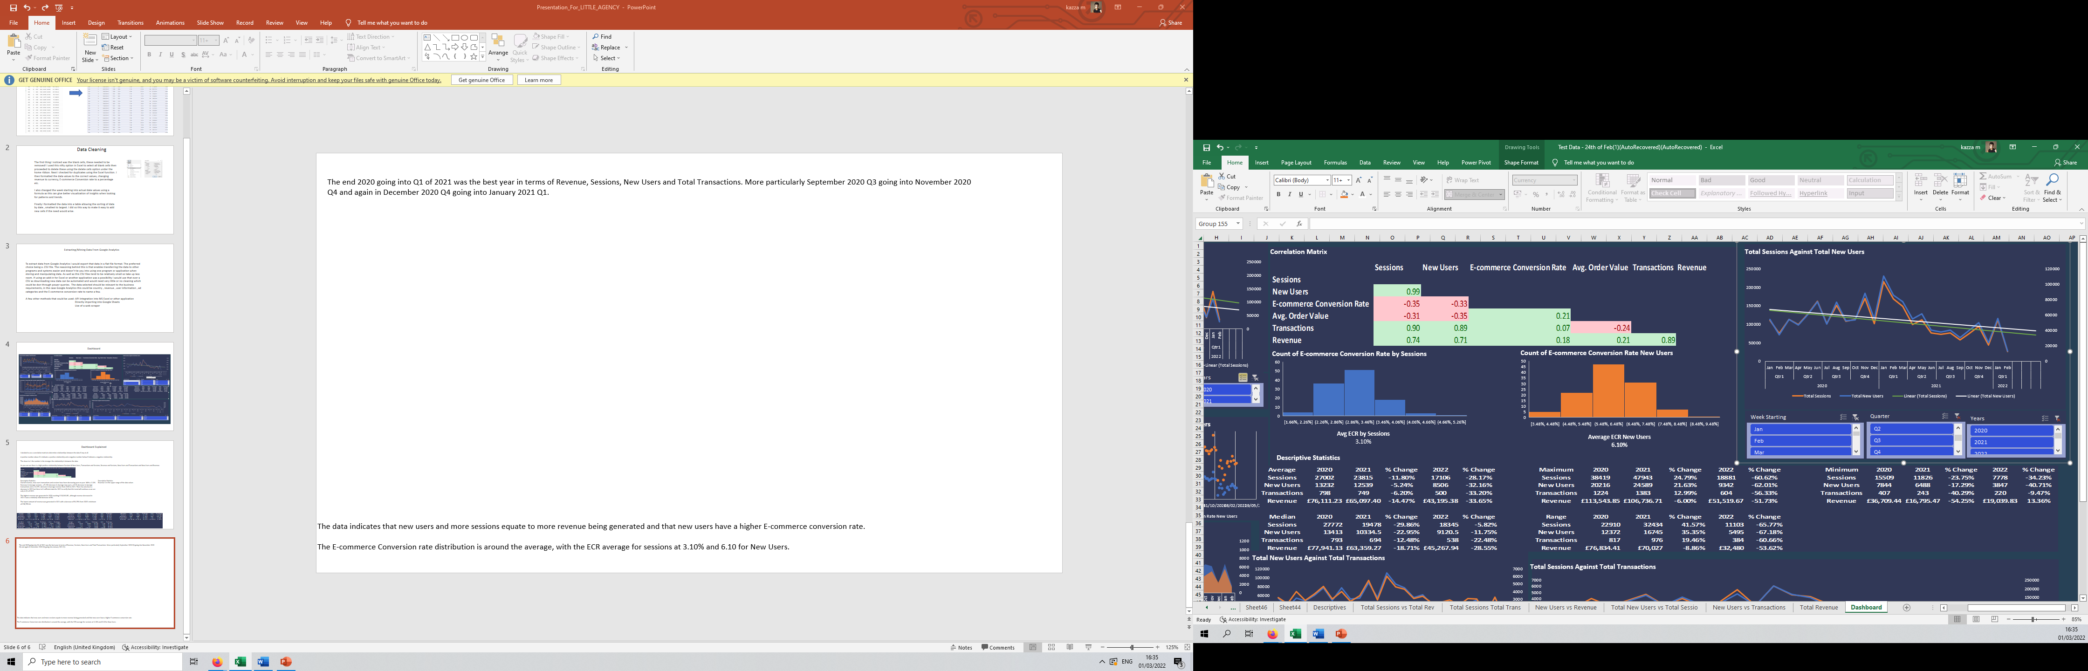
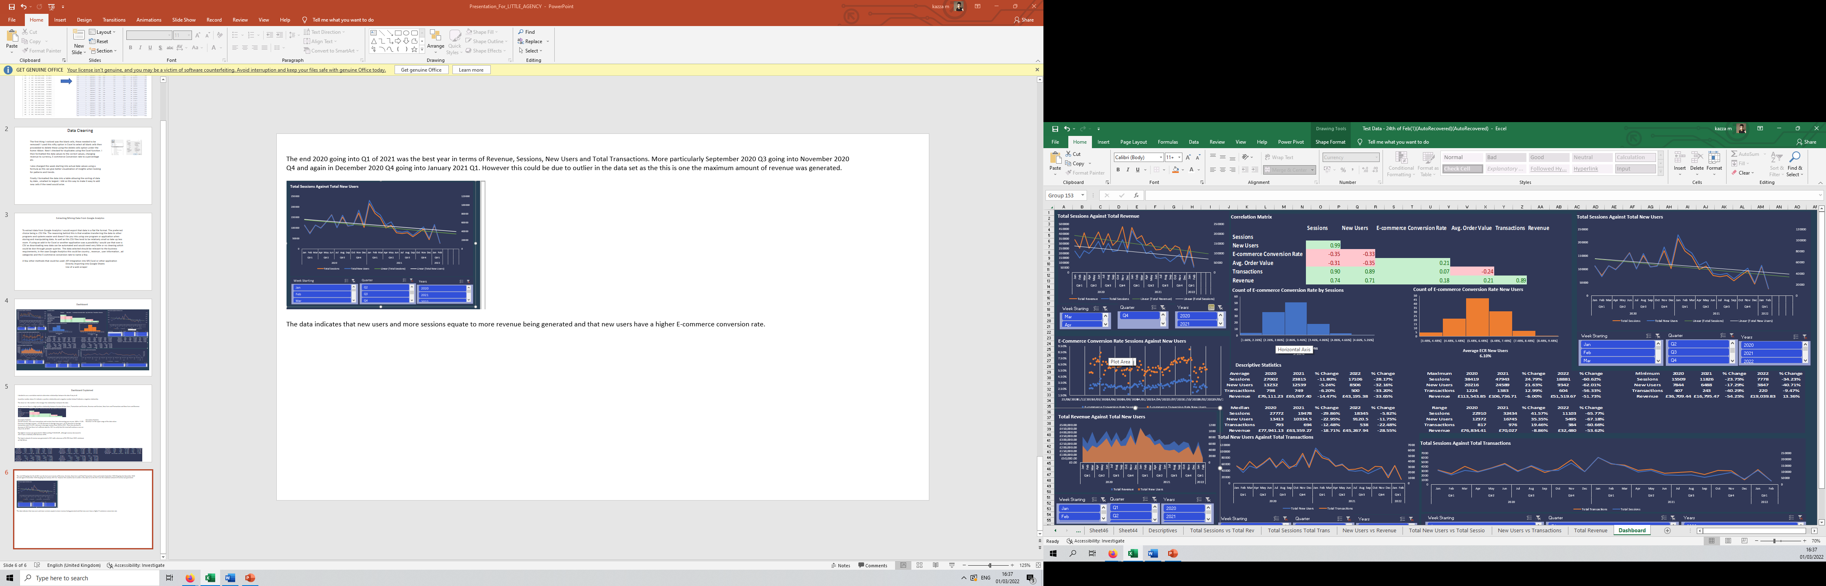
The end 2020 going into Q1 of 2021 was the best year in terms of Revenue, Sessions, New Users and Total Transactions.
More particularly September 2020 Q3 going into November 2020 Q4 and again in December 2020 Q4 going into January 2021 Q1.
There was a decrease in the total sessions and amount of revenue at the same time as new users and sessions, indicating a relationship between these three data points.
Revenue and sessions are decreasing overall and a continuation of a downwards trend is predicted to continue.

Slide 5
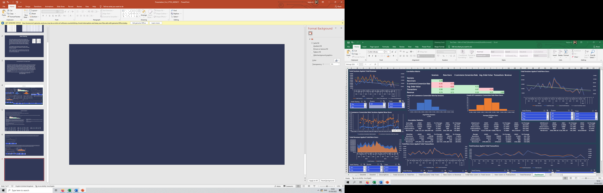
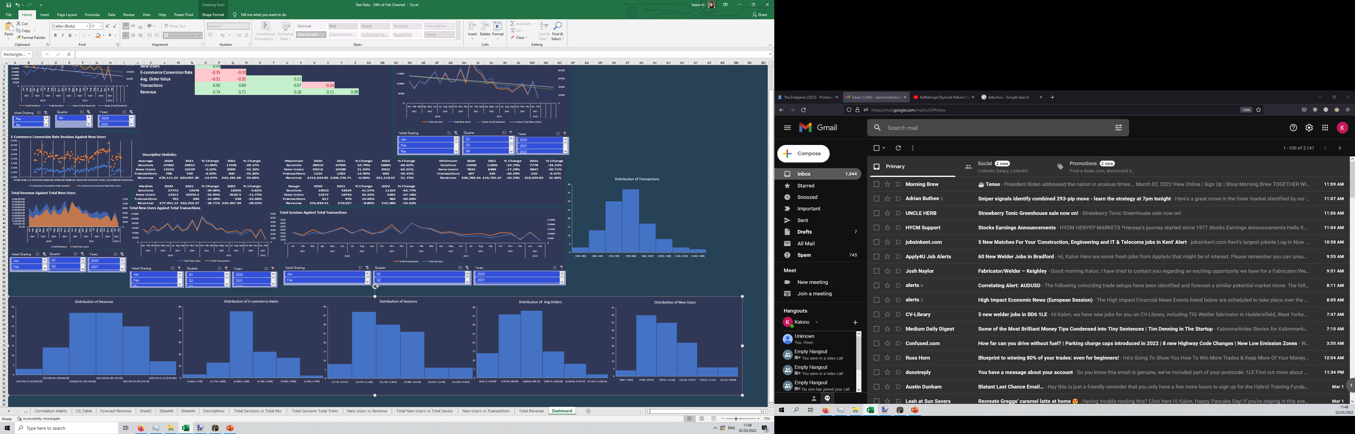
The Total amount of New Users and Total Transactions have a close relationship as do Total Sessions and Total Transactions.
The New Users against Total Transactions chart indicates that new users could contribute a towards a high proportion of transactions.
The Total Sessions against Total Transactions chart indicates that contribute towards a higher proportion of total transactions.
Distribution of data , as you can see it is relatively symmetrical with some outliers in the upper and lower portions of the data.

Slide 6
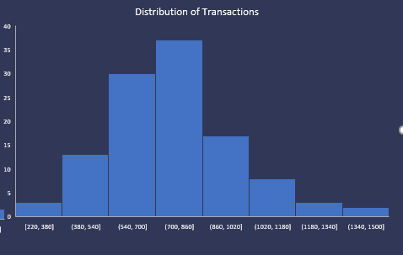
Insights
A positive relationship between Sessions & New Users, Transactions and Sessions, Revenue and Sessions, New Users and Transactions and New Users and Revenue.
Overall revenue, new users transactions and sessions have been decreased from 2020 to 2021.
The median and average of the data are relatively close indicating that it has a symmetrical distribution.
New Users contribute more towards revenue.
Higher Sessions contribute towards revenue
E-commerce rates indicate that users are performing intended actions on average and more so with New Users
E-commerce conversion rates by new user on average are 6.10% between 2020 and 2022 so far and have a relatively even distribution
Outliers in the upper and lower portions of the data
More outliers in the upper values suggest by the range
Data indicates potentially an ad campaign run in Q4 of 2020 to Q1 of 2021 and in 2021 Q4 to 2022 Q1. due to the sharp increase and sudden decrease in values data New Users, Transactions and Sessions, Revenue and Sessions
The data has a number of factors that could have contributed towards the findings the first being that it is a relatively small set and could lead to some skewing of results. The positive relationship between Sessions & New Users, Transactions and Sessions, Revenue and Sessions, New Users and Transactions and New Users and Revenue could be due to an ad campaign being run in Q4 of 2020 to Q1 of 2021 and in 2021 Q4 to 2022 Q1 noted by the sudden sharp increases and decreases in values. These values where found to be outliers and only happened at particular times specifically Q4 going into Q1.

Slide 7
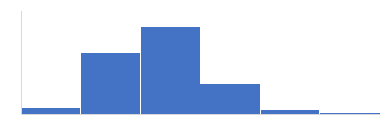
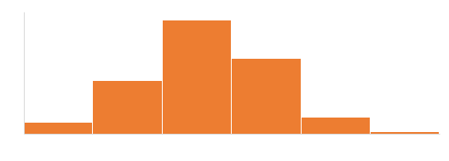
Missing Slide
Avg ECR by Sessions
3.10%
Average ECR New Users
6.10%
E-Commerce Conversion Rate Sessions Against New Users

